Slide 1
Garbage collection in .NET
Comparing with Java, Python and JavaScript approaches
Author: Yuriy Shapovalov

Slide 2
Agenda
Reference counting vs. tracing vs. copying collection
Memory allocation process
Mark and sweep (and compact) algorithm
Generations
Dispose pattern

Slide 3

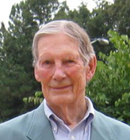
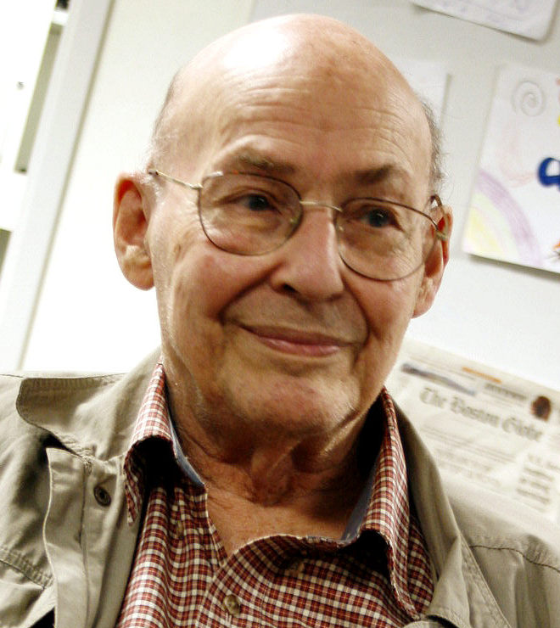
GC Algorithms
Tracing [McCarthy, 1960]
“Mark and Sweep”
Reference Counting [Collins, 1960]
Copying Collection [Minsky, 1963]
“Stop and Copy”

Slide 4
Tracing (mark and sweep)
Stop process
Trace forward from roots
Everything touched in live, all else is garbage
Roots

Slide 5
Tracing (mark and sweep)
Stop process
Trace forward from roots
Everything touched in live, all else is garbage
Roots

Slide 6
Tracing (mark and sweep)
Stop process
Trace forward from roots
Everything touched in live, all else is garbage
Roots

Slide 7
Tracing (mark and sweep)
+ Able to reclaim garbage that contains cyclic references.
+ There is no overhead in storing and manipulating reference counting fields.
+ Objects are not moved during GC – no need to update references to objects
- It many increase heap fragmentation
- It does work proportional to the size of entire heap.
- The program must be halted during garbage collecting.

Slide 8
Reference Counting
Each object has counter of incoming pointers
When counter reaches zero, object can be collected.
root
1
2
0
1
2
0
1
0
2
3
1

Slide 9
Reference Counting
Each object has counter of incoming pointers
When counter reaches zero, object can be collected.
root
1
2
0
1
2
0
1
0
2
3
1

Slide 10
Reference Counting
Each object has counter of incoming pointers
When counter reaches zero, object can be collected.
root
1
1
1
2
0
1
2
1

Slide 11
Reference Counting
Each object has counter of incoming pointers
When counter reaches zero, object can be collected.
root
1
1
1
2
1
1

Slide 12
Reference Counting
Each object has counter of incoming pointers
When counter reaches zero, object can be collected.
- Have a problem with cyclic dependencies
root
1
1
1
1
1
2
1
1
1
1

Slide 13
Reference Counting
+ Simple. Garbage is easily identified.
+ Easy to implement.
+ Immediate reclamation of storage.
- The overhead of incrementing and decrementing the reference count each time
- Extra space for counter field in each object.
- It may increase heap fragmentation
- Does not detect garbage with cyclic references.

Slide 14
Copying collections
Memory is organized into two areas
old space: used for allocation
new space: used as a reserve for GC
GC starts when the old space is full.
Copies all reachable objects from old space to new.
Reverse roles of the old and new spaces.
old space
new space
root
a
b
c
d

Slide 15
Copying collections
Memory is organized into two areas
old space: used for allocation
new space: used as a reserve for GC
GC starts when the old space is full.
Copies all reachable objects from old space to new.
Reverse roles of the old and new spaces.
old space
new space
root
a
b
c
d

Slide 16
Copying collections
Memory is organized into two areas
old space: used for allocation
new space: used as a reserve for GC
GC starts when the old space is full.
Copies all reachable objects from old space to new.
Reverse roles of the old and new spaces.
old space
new space
b
d
root
a
c

Slide 17
Copying collections
Memory is organized into two areas
old space: used for allocation
new space: used as a reserve for GC
GC starts when the old space is full.
Copies all reachable objects from old space to new.
Reverse roles of the old and new spaces.
new space
old space
root
a
c

Slide 18
Copying collections
+ Only one pass through the data is required
+ It de-fragment the heap
+ Able to reclaim garbage with cyclic references.
+ No overhead with reference storage and manipulating.
- Twice as much memory is needed for a given amount of heap space
- Objects are moved in memory during garbage collection (references need to be updated)
- The program must be halted during garbage collecting.

Slide 19
Comparison
 | Tracing | Reference counting | Copying collections
Collection style | batch | incremental | copy
Pause Times | long | short | long
Real Time | no | yes | no
Delayed Reclamation | yes | no | no
Cost per mutation | none | high | low
Collects cycles | yes | no | yes

Slide 20
Copying collections

Slide 21
Memory Allocation process
Before CLR executes the first line of the managed code, it creates three application domains.
System Domain
Shared Domain
Default AppDomain
Define size of object MyClass
Allocate memory
MyClass instance = new MyClass();

Slide 22
Memory Allocation process
Define size of object MyClass
Allocate memory
MyClass instance = new MyClass();

Slide 23
CLR Bootstrap

Slide 24
Mark and Sweep
Roots
Processes
global
stack
CPU registers
stack
stack

Slide 25
GC in Python
Generational Reference Counting
The same as .NET CLR, has 3 generations.
GC can be disabled, and programmer can switch it off.
Using reference counting with specific procedure of cycles handling.

Slide 26
GC in JavaScript (V8 as example)
Non-generational Mark and Sweep
Every objects in scope is called a "scavenger". GC create a "scav" list of this object.
When GC runs, it mark every object, variable, string, etc.
Then, it clear the mark from objects in "scav" list, and the transitive closures of scavenger references.
At this point we know that all the memory still marked is allocated memory which cannot be reached by any path from any in-scope variable.

Slide 27
GC in JavaScript (SpiderMonkey)
Incremental (Tracing) Mark and Sweep
Allows eliminate downtimes during garbage collecting.
GC usually happen every 5
"Incremental garbage collection fixes the problem by dividing the work of a GC into smaller pieces. Rather than do a 500 millisecond garbage collection, an incremental collector might divide the work into fifty slices, each taking 10ms to complete. In between the slices, Firefox is free to respond to mouse clicks and draw animations.“
http://blog.mozilla.org/javascript/2012/08/28/incremental-gc-in-firefox-16/

